Slide 1
Chapter 1
INTRODUCTION TO PSYCHOLOGY

Slide 2
Announcement!
First Research Event of the semester!
It will be a talk about anxiety and coping
Event: Brittany Richmond, Guest Speaker from Rae of Hope Foundation
Date: Tuesday, Jan 20th
Time: 5:30 - 6:30 pm
Location: COPH 130
Registration: Not required
Research Points: 1 hr = 30 points available
How to Earn Points: Step 1. Go to the event, and take a picture/ selfie of yourself at the event (it should be clear from the picture that you are at the event). Step 2: Email Dr. S (scheulerb2@unk.edu) the picture of yourself at the event, and 1 paragraph describing the event and what you learned.

Slide 3
Agenda
What is Psychology?
History of Psychology
Contemporary Psychology
Careers in Psychology
Reminders

Slide 4
What is Psychology?
Psych – Soul
Ology – Scientific study of
Psychology – Scientific study of the mind and behavior.
Psychologists study everything about the human experience from the basic workings of the human brain to consciousness, memory, language, reasoning, personality and mental health.

Slide 5
The History of Psychology

Slide 6
Psychological Perspectives
Structuralism – understanding the conscious experience through introspection.
Functionalism – focused on how mental activities helped an organism adapt to its environment.
Psychoanalytic Theory – focuses on the role of the unconscious in affecting conscious behavior.
Gestalt Psychology – Focuses on humans as a whole rather than individual parts.
Behaviorism – focuses on observing and controlling behavior.
Humanism - emphasizes the potential for good that is innate to all humans.

Slide 7
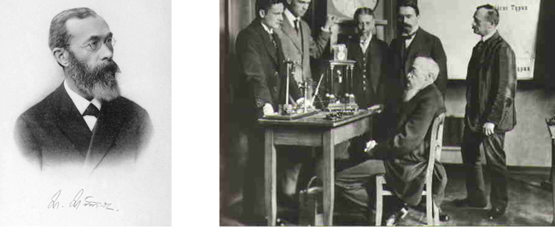
Structuralism - Wilhelm Wundt
Wilhelm Wundt is credited as one of the founders of psychology. He created the first laboratory for psychological research.
Wundt emphasized structuralism. He focused on understanding the structure and characteristics of the mind through introspection.
Introspection - Process by which someone examines their own conscious experience in an attempt to break it into its component parts

Slide 8
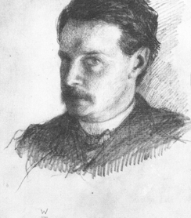
Functionalism – William James
William James, shown here in a self-portrait, was the first American psychologist.
James drew from the functionality of cognitive processes, establishing functionalism.
Functionalism - emphasized how mental activities contributed to basic environmental survival.

Slide 9
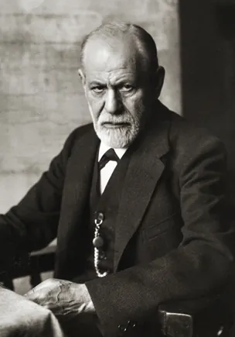
Psychoanalytic Theory – Sigmund Freud
Founded Psychoanalytic theory, a perspective which dominated clinical psychology for many decades.
Studied “hysteria” and neurosis.
Theorized that many of his patients’ problems arose from the unconscious mind.
Believed that one way the unconscious mind could be accessed was through dream analysis.
Psychoanalytic theory focuses on the role of a person’s unconscious and early childhood experiences.

Slide 10


Gestalt Psychology
Kohler, Koffka and Wertheimer were German psychologists who immigrated to the U.S. to escape Nazi Germany.
Gestalt – “Whole”
Based on the idea that although a sensory experience can be broken down into individual parts, how those parts relate to each other as a whole is often what the individual responds to in perception.
Ideas of Gestalt continue to influence research on sensation and perception.

Slide 11
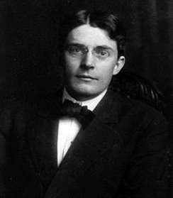
Behaviorism - John B. Watson
John B. Watson is known as the father of behaviorism within psychology.
Believed that objective analysis of the mind was impossible.
Watson focused on observable behavior and ways to bring that behavior under control.
Conducted the “Little Albert” experiment
Today, behaviorism is used in behavioral and cognitive-behavioral therapy.

Slide 12
Behaviorism – Ivan Pavlov
Discovered the concept of classical conditioning.
Studied conditioned reflexes in which an animal produced a reflex (unconscious) response to a stimulus (salivating in the presence of food) and, over time, was conditioned to produce the response to a different stimulus (salivating to the sound of a bell) that the experimenter associated with the original stimulus (Food and bell became associated).
(Credit: Emaze)

Slide 13
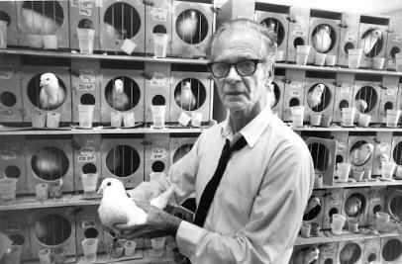
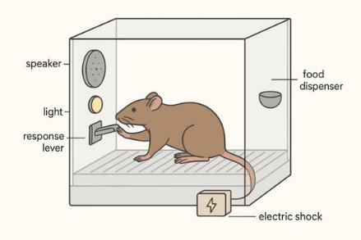
Behaviorism - B. F. Skinner
Concentrated on how behavior was affected by its consequences.
Studied the principles of modifying behavior through reinforcement and punishment which he saw as major factors in driving behavior (operant conditioning).

Slide 14
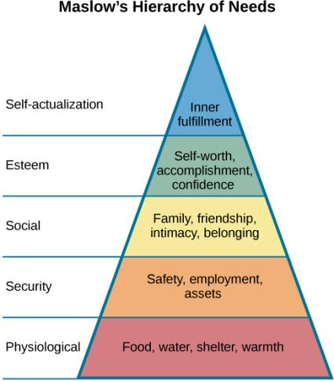
Humanism- Abraham Maslow & Carl Rogers
Abraham Maslow
Maslow proposed a hierarchy of human needs in motivating behavior.
Maslow asserted that so long as basic needs necessary for survival were met (e.g., food, water, shelter), higher-level needs (e.g., social needs) would begin to motivate behavior.
Carl Rogers
Carl Rogers developed a client-centered therapy which focused on the patient taking a lead role in the therapy session.
Rogers believed therapists need:
unconditional positive regard
genuineness
empathy

Slide 15
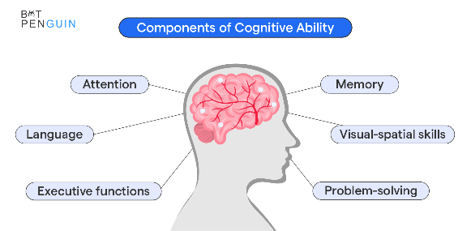
The Cognitive Revolution
By the 1950’s, new disciplinary perspectives in linguistics, neuroscience, and computer science were emerging.
The mind became the new focus of scientific inquiry.
Noam Chomsky
Noam Chomsky was very influential in beginning the cognitive revolution.
He believed psychology needed to incorporate mental functioning into its focus in order to fully understand human behavior.

Slide 16
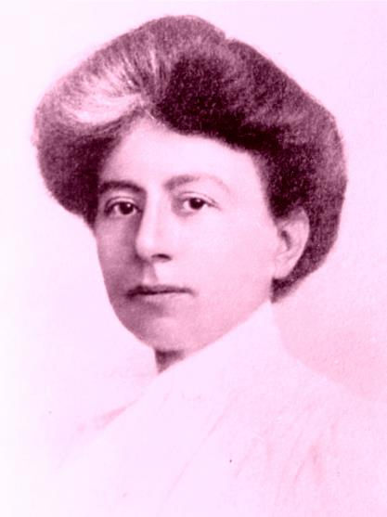
Margaret Floy Washburn
First woman to earn a doctorate in Psychology (in 1894)
Made notable contributions on animal behavior and motor theory

Slide 17
Contemporary Psychology

Slide 18
Some of the Branches of Psychology
Biopsychology and Evolutionary Psychology
Sensation and Perception
Cognitive Psychology
Developmental Psychology
Personality Psychology
Social Psychology
Health Psychology
Industrial-Organizational Psychology
Sports and Exercise Psychology
Clinical Psychology
Forensic Psychology
Mathematical Psychology & Psychometrics

Slide 19
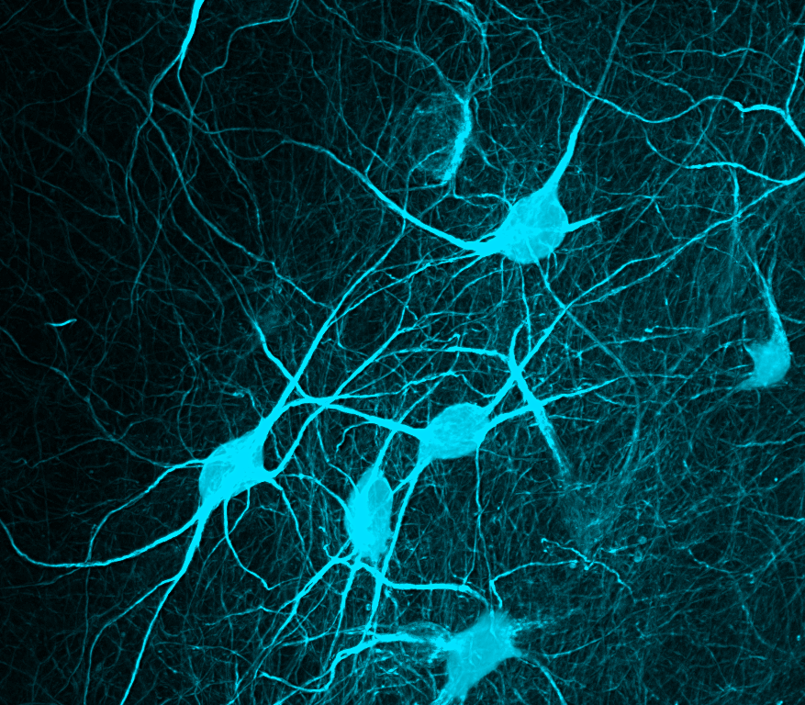
Biopsychology
Biological psychologists study how the structure and function of the nervous system generate behavior.
Research can include:
Sensory and motor systems
Sleep
Drug use and abuse
Ingestive behavior
Reproductive behavior
Neurodevelopment
Plasticity of the nervous system
Biological correlates of psychological disorders

Slide 20
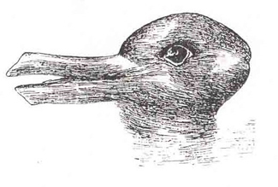
Sensation and Perception
This area of study focuses on both physiological aspects of sensory systems and the psychological experience of sensory information.
Sensation – Sensory information (sights, sounds, touch, smell).
Perception – Experience of the world which is influenced by where we focus our attention, our previous experiences, and our cultural backgrounds.
When you look at this image, you may see a duck or a rabbit. The sensory information remains the same, but your perception can vary dramatically.

Slide 21

Cognitive Psychology
Cognitive psychology is the area of psychology that focuses on studying cognitions, or thoughts, and their relationship to our experiences and our actions.
Example topics include:
Learning & problem solving
Intelligence
Language
Memory
Attention
This Photo by Unknown Author is licensed under CC BY-SA-NC

Slide 22
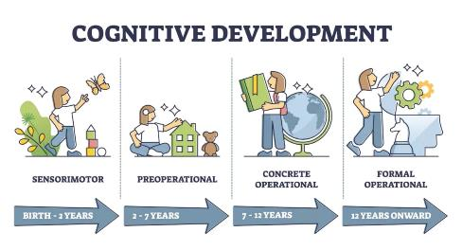
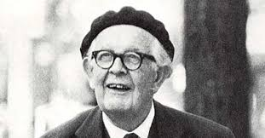
Developmental Psychology
Developmental psychology studies the physical and mental attributes of aging and maturation.
This can include various skills that are acquired throughout growth.
  Moral Reasoning
  Cognitive Skills
  Social Skills
Jean Piaget is famous for his theories regarding changes in cognitive ability that occur as we move from infancy to adulthood.

Slide 23
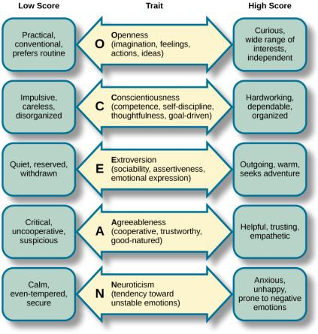
Personality Psychology
Focuses on behaviors and thought patterns that are unique to each individual.
Studies in this field include conscious and unconscious thinking and identifying personality traits.
The Big Five (The Five Factor Model)
Each of the dimensions of the Five Factor model is shown in this figure.
The provided description would describe someone who scored highly on that given dimension. Someone with a lower score on a given dimension could be described in opposite terms.

Slide 24

Social Psychology
How individuals interact and relate with others and how such interactions can affect behavior.
Prejudice
Attraction
Interpersonal conflicts
Obedience

Slide 25
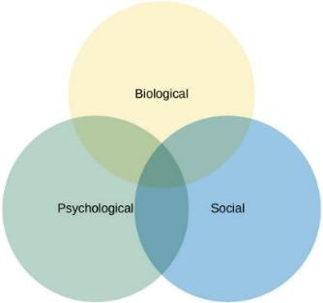
Health Psychology
Branch that focuses on what makes people ill or healthy, as well as what they experience while sick
The biopsychosocial model suggests that health/illness is determined by an interaction of these three factors.
Applications include:
  Studying trends in risk factors
  Evaluating stress and how it can cause disease development
  Assessing the role of social support in patient incomes

Slide 26
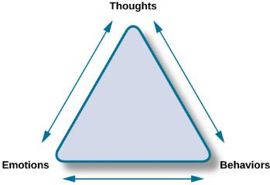
Clinical Psychology
Focuses on diagnosis and treatment of psychological disorders and problematic patterns of behavior.
Study involves clinical therapy and counseling.
Cognitive-behavioral therapists take cognitive processes and behaviors into account when providing psychotherapy. This is one of several strategies that may be used by practicing clinical psychologists.

Slide 27
And More…
Industrial-Organizational (IO Psychology)
Branch that applies psychological theories, principles and research to industrial and organizational settings.
Involves issues related to personnel management, organizational structure and workplace environment.
Sports & Exercise Psychology
Focus on psychological aspects regarding sports and physical performance.
Study includes motivation, performance related anxiety, and general mental well being.
Forensic Psychology
Branch of psychology dealing with justice system.
Tasks of Forensic Psychologists include assessment of individuals' mental competency to stand in trial, sentencing and treatment suggestions, and advisement regarding eyewitness testimonies.
This field of psychology requires a strong understanding of the legal system.
Mathematical Psychology & Psychometrics
Branches of psychology that focus on assessment
Psychometrics focuses on how we develop assessments, while mathematical psychology focuses on the analyses we use in our assessments

Slide 28
Careers in Psychology

Slide 29
Careers in Psychology
Most careers in psychology require a PhD or a Masters degree.
A few career options:
Teaching
Research
Clinical psychologist
Counseling psychologist
Social Work
Corporate and Marketing jobs
There are plenty of other careers where a psychology background is applicable.
For example:
Statisticians
Corporate/ management
Health services (including those in veterans affairs)
Social work
Marketing and sales
Human resources (personnel and training)

Slide 30
Next Time on PSY 203…
Before Next Class:
Take the pre-assessment on Canvas
  Due tomorrow by midnight!
Take the syllabus quiz
  Due 1/22
Complete the introduction sheet
  Due 1/22
Read Chapter 2
Take the Chapter 2 Quiz
  Due 1/20 at 2pm
Next Class:
Discussing Chapter 2- Psychological Research

